Slide 1
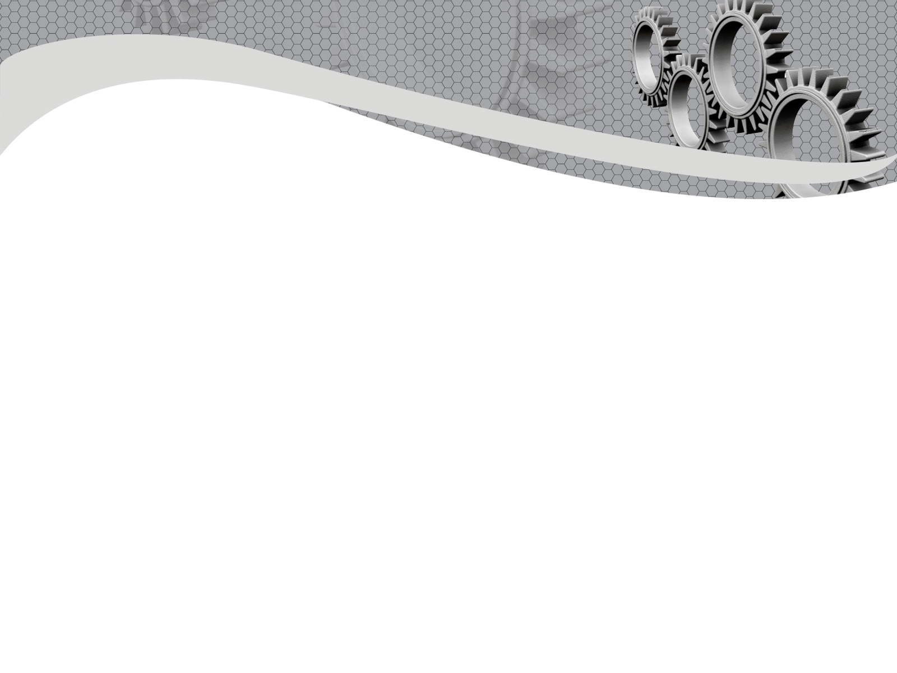

Department of Mechanical Engineering
Mini Project
on
Design & Fabrication of Vertical Axis Wind Turbine for Highway Application
Presented by
1NH16ME003 | Abhishek
1NH16ME028 | Ganesh S
1NH16ME092 | Rohit Kumar Singh
1NH16ME093 | Srevarun S
Guided by
Mr. C Rakesh
Asst Professor

Slide 2
Contents
Problem Statement
Objective
Literature Surveys & Summary
Material Selection
Design
Design Specifications
Design Calculations
Experimental Results
Components of Full Scale VAWT
Concept of Electromagnetic Propulsion
Future Work
GANTT Chart
References

Slide 3
Problem Statement
Following the concept of 3 E’S
After going through a lot of journals and literature reviews, we were able to understand that it is very difficult to get a highly efficient vertical axis wind turbine. At the same time, production charges and cost of the turbines are also high which decreases overall feasibility.
So we are trying to maintain a balance between Efficiency and Economy for proper results.
The third E is Ecology. The whole purpose of taking up this project itself is how we can use one of the sources of energy, which does not produce any kind of pollutant and overall do not produce any green house gases.

Slide 4
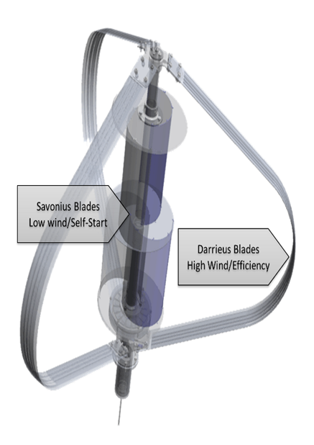
Objective
Design and fabrication of Vertical Axis Wind Turbine.
To make important changes in the design based on the literature results.
Design based for correct optimization and experimental validation.
Testing the developed model.

Slide 5
Effect of Blade Number on Performance of Drag Type Vertical Axis Wind Turbine M. Zheng, Y. Li, H. Teng
Literature Survey
ABSTRACT
SUMMARY
The effect of blade number on performance of drag type vertical axis wind turbine (VAWT) is studied by Ansys numerical simulation, it involves 3-blade, 5-blade and 6-blade VAWTs. The optimized width of blade for each VAWT at maximum power efficiency is obtained, and simulation for the wind turbine with different number of blade is conducted for the VAWTs with turbine radius of 2 m at the inlet wind speed 8 m/s.
Through the analysis for wind turbine with the same turbine radius (2 m) and the inlet wind speed 8 m/s, it concludes:
(1) The optimal L/D varies with blade number of wind turbine.
(2) The optimal L/D for the 3-blade wind turbine is 0.66–0.67; its optimum power efficiency is 20.44%, the corresponding rotation rate is 20 rpm.
(3) The optimal L/D for the 5-blade wind turbine is 0.40, its optimum power efficiency is 24.30%, and the corresponding rotation rate is 17 rpm.
(4) The optimal L/D for the 6-blade wind turbine is 0.34 ~ 0.35, its optimum power efficiency is 26.82%, and the corresponding rotation rate is 18 rpm.
(5) The stability of the wind turbine and the optimum power efficiency increase with the number of blades for turbine with the same radius and the inlet wind speed.

Slide 6
Selection of Material for Wind Turbine Blade by Analytic Hierarchy Process (AHP) Method Lahu P.
ABSTRACT
SUMMARY
Wood, Glass fiber, carbon fiber, natural fiber, sandwich composite metal alloy materials are different material available for small wind turbine blades. Strength, durability, density, cost, and availability are the important properties to be considered during material selection of blade. The selection of material for wind turbine blade is an important stage in blade design. This paper presents a simple Analytic Hierarchy Process for material selection for the small wind turbine blade. AHP is one of the simplest and cost effective decision making method. In this work AHP is successfully applied for material selection for small wind turbine blade.
AHP method is proved practical enough for selecting the material for wind turbine blade. It is extremely useful for making decision in case of complicated criteria and vast alternatives available however the Weight given to the criteria by the different individual according to his requirements may change the result.

Slide 7
Materials for Wind Turbine Blades: An Overview Leon Mishnaevsky
ABSTRACT
SUMMARY
A short overview of composite materials for wind turbine applications is presented here. Requirements toward the wind turbine materials, loads, as well as available materials are reviewed. Apart from the traditional composites for wind turbine blades (glass fibers/epoxy matrix composites), natural composites, hybrid and nanoengineered composites are discussed. Manufacturing technologies for wind turbine composites, as well their testing and modelling approaches are reviewed.
Carbon fibers represent a very promising alternative to the traditional E-glass fibers. Other alternatives are high strength glasses, basalt, aramid and natural fibers. Carbon fibers ensure higher stiffness while their disadvantages are higher costs, lower compressive strength and high sensitivity to local defects (e.g., misalignment). In several studies, the combination of carbon and E-glass fibers was recommended as a promising solution, which allows to achieve the combination of higher stiffness (due to carbon fibers) with limited cost increase. With view of resin matrix, thermoplastics have some advantages over traditionally used thermosets, e.g., recyclability.

Slide 8
Material Selection
THE DIFFERENT TYPES OF MATERIALS AVAILABLE AND REASON FOR NOT SELECTING
Sl No. | MATERIALS | DISADVANTAGES
1. | Plastic | Plastics are non-biodegradable.
2. | Composites | Very costly.
3. | Carbon Fiber | Carbon fiber will break or shatter Carbon fiber are also costly.
4. | Steel | Highly Corrosive.

Slide 9
PREFERRED MATERIAL
Sl No. | MATERIAL | ADVANTAGES
1. | Aluminium | Low corrosion rates compared to rust, specially if anodized. It is metal so good conductor of electricity. Aluminium has a very high strength. It's weight advantage is also useful in the transport industry.

Slide 10
Power Generation by Hybrid VAWT System for Highway Applications Menaka Mohan
ABSTRACT
SUMMARY
In this paper, the generation of electricity is achieved by using vertical axis wind turbine using the force created by moving vehicles. In this paper, two types of turbine blade model are made as a hybrid in VAWT (Vertical Axis Wind Turbine) which increases the efficiency in wind energy utilization. Due to this hybrid model, drag and lift are increased and rotate automatically even with low wind speed. The power generated by this VAWT can be utilized for highway applications, and then the excess power will be injected into the grid or local area. The power is stored in the battery bank which is placed under the windmill and utilized at the night time for lighting purpose on the highway
Therefore, the energy can be converted into electricity even from the moving vehicles on the highway. This project can also be developed by changing the number of blades and with the materials used. This is applicable for the entire region, and the regional parameters also are taken in to account for the better results. Hence this hybrid model has achieved 2.75 times higher efficiency from the existing model, in the simulation with the wind tunnel tests and the lift and drag parameters, 1.25 times higher efficiency is achieved.

Slide 11
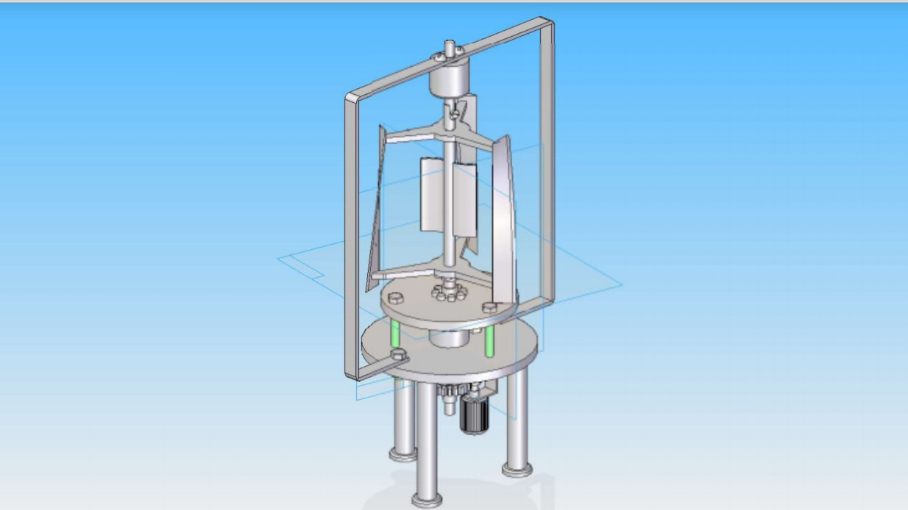
Design

Slide 12
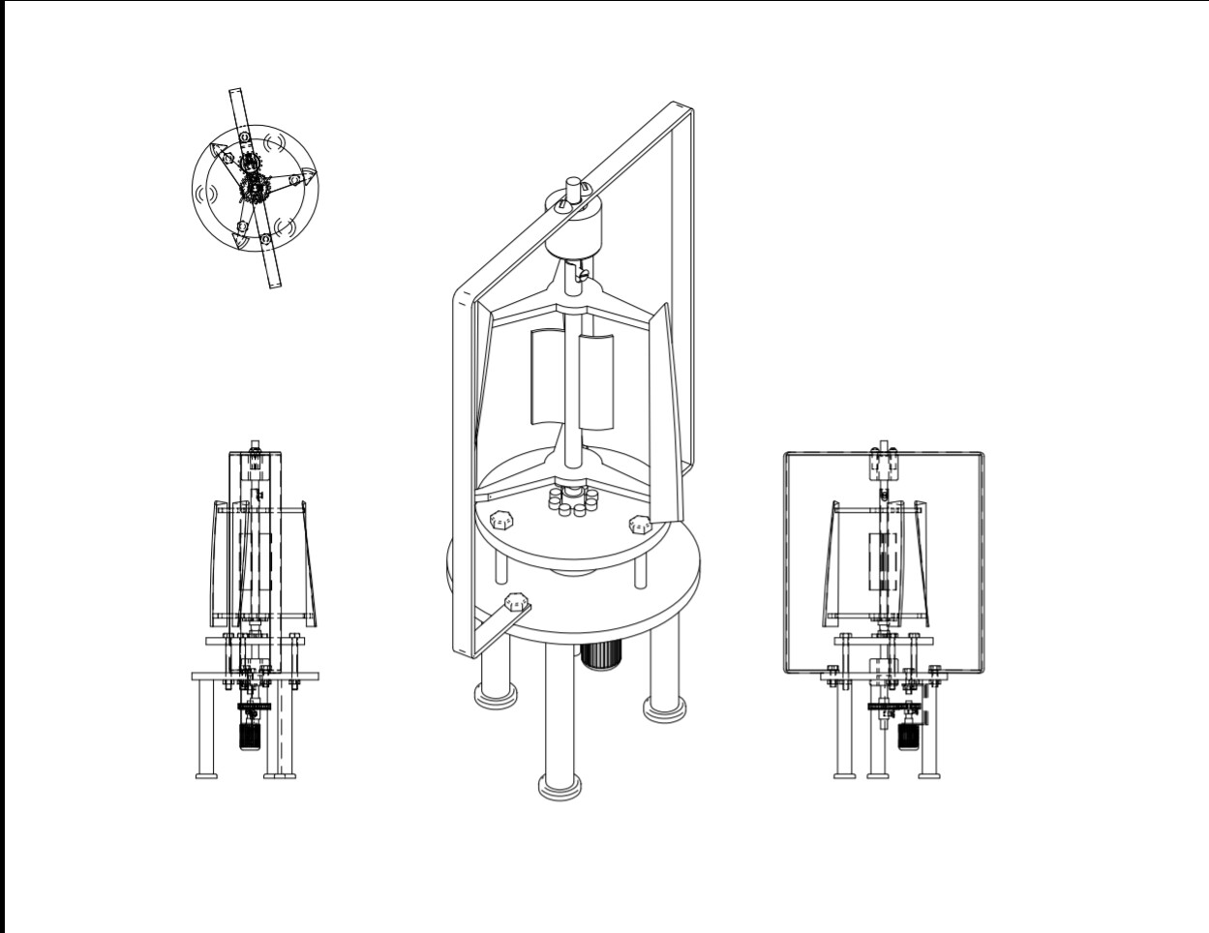
Top view, Isometric view, Front view

Slide 13
Design Specifications
Wind rotor | Rated power | 35W
 | Rotor Diameter | .38m
 | Swept area | .2128 m²
 | Gear box type | Spur gear
Generator | Type | DC Generator
 | Speed | 500 rpm
 | Voltage | 12V
Turbine Blade | Type | Darrieus
 | Number of Blades | 3
 | Blade material | Aluminium 6061
Blade dimension | length | 0.56m
 | radius | 0.38m

Slide 14
Design Calculations
5.1 Design for strength:
Design for the VAWT starts with swept area (A) calculation, A = H*D (H= Rotor Height, D= Rotor Diameter) A = 0.56 ∗ 0.38 = 0.2128 m² Design and calculation of straight bladed VAWT is performed by considering the speed of wind that will hit the blade, and also kinematic viscosity (𝜗), air density (𝜌) and no. of blades.
For this project it is assumed that, TSR (𝜆) = 1 (TSR = 1-4 for small scale generation
TSR = 5- 9 for Large scale generation) Number of blades (Nb) = 3 Wind velocity, (v) = 6 m/s Kinematic viscosity, (𝜗) = 0.0000178 kg/ms Air density, (𝜌) = 1.29 kg/m³

Slide 15
Power in the wind is, Pw = 1/2∗ 𝜌 ∗ A ∗ v3 Pw = 1/2∗ 1.29∗ 0.2128 ∗ 216 = 27.57 W
Mechanical power can be calculated by formula, Pm=1/2∗ 𝜌 ∗ A ∗ 16/27 ∗ v3 Pm =1/2∗ 1.29∗ 0.2128 ∗16/27 ∗ 216 = 16.34 W
Where, 16/27 is Betz limit, this value was given by Albert Betz who was physicist in 1919, and he proposed that 16/27 = 0.599 is maximum power of efficiency of wind turbine which convert kinematic energy to mechanical energy.
Angular velocity (𝜔) can be calculated as, 𝜔 = 𝜆 ∗ v/R 𝜔 = 1 ∗ 6/0.19 = 31.57 rad/sec
N = 𝜔 ∗ 60/2𝜋 N = 31.57 ∗ 60/2𝜋 = 301.55 rpm
Chord length, (C) can be calculated as: C = 𝜍 ∗ R/Nb C = 0.6 ∗ 0.19/3 = 0.04 m Where solidity, 𝜍 = 0.6 as Reynolds no is 1.6*10^5

Slide 16
Lift force which causes blade to lift Fl = 1/2∗ Cl ∗ 𝜌 ∗ C ∗ 𝜔2 Fl = 1/2∗ 0.80 ∗ 1.29 ∗ 0.04 ∗ 31.57 ∗ 31.57 = 20.57 N Where Cl = coefficient of lift = 0.80
The drag force resisting the wind speed is, Fd = 1/2 ∗ Cd ∗ 𝜌 ∗ C ∗ 𝜔2 Fd = 1/2 ∗ 0.04 ∗ 1.20 ∗ 0.04∗31.57 ∗ 31.57 = 1.02 N Where Cd= coefficient of drag =0.04
Torque to be transmitted is, T = Pm ∗ 60/2𝜋 ∗ N T = 16.34 ∗ 60/2𝜋 ∗ 301.55 = 0.517 Nm

Slide 17
Experimental Results
Calculation results
Serial No. | Wind speed (m/s) | Power generated (W)
1 | 7 | 28.2
2 | 8 | 42.09
3 | 9 | 59.93
Experimental results
Serial No. | Speed (kmph) | Voltage (V) | Current (A) | Power (W)
1 | 15 | 8.5 | 1.25 | 10.625
2 | 20 | 9.7 | 1.58 | 15.326
3 | 25 | 11.2 | 1.89 | 21.168

Slide 18
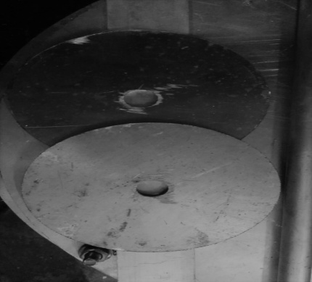
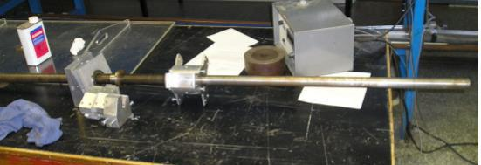
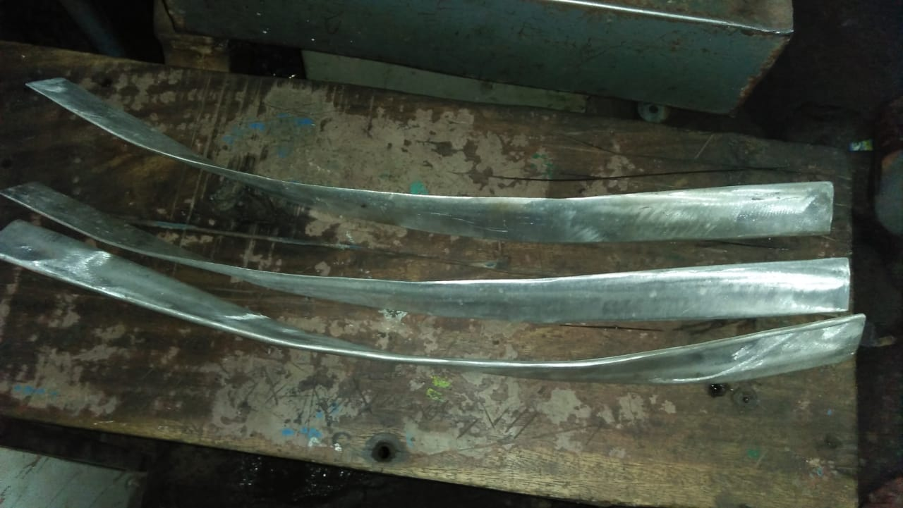
Components of full-scale VAWT
Part | Description | Image
Base plates | Two base plates are made of MS-steel Bottom-most base plate diameter- 48cm Other plate diameter- 40cm 3 base extensions to maintain stability
2. Shaft | Outer hollow shaft diameter- 1.5cm Inner shaft diameter- 1cm Material- Aluminium Shaft has 2 ring magnets(10mm*20mm)
3. Blades | Number of blades- 3 blades Thickness of each blade- 5mm obtained by grinding 12mm thickness plate Blades are then twisted by fixing one of the ends to a vice and using a wrench.

Slide 19
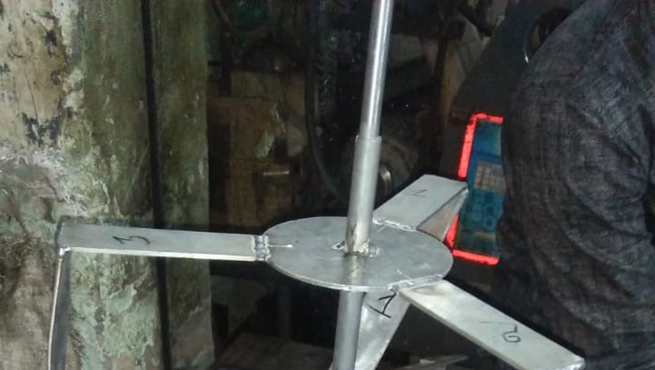
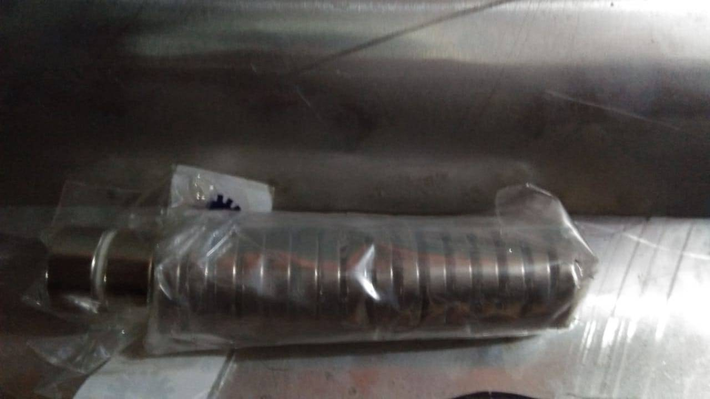
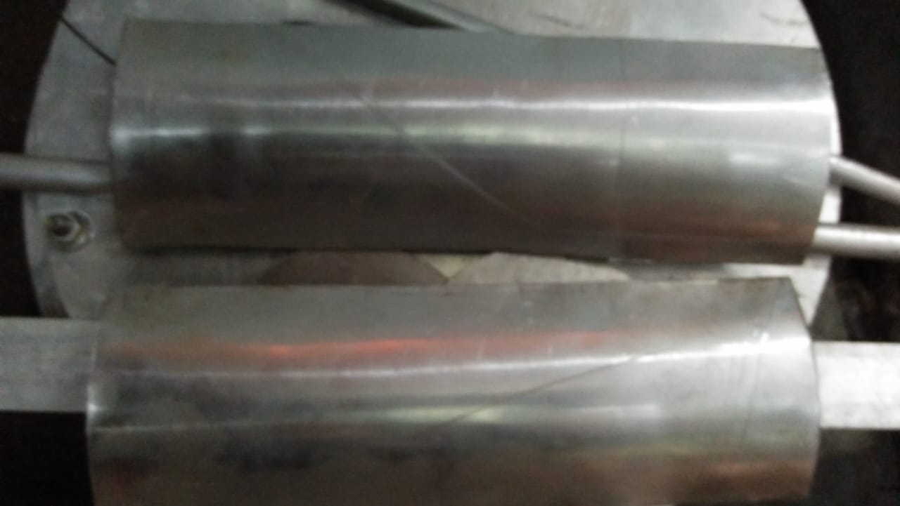
Part | Description | Image
4. Blade Shaft Connectors | Aluminium used for the six radial connecting arms Provide a means to mount the blades with the centre shaft Tig- welding is performed to keep the blades in-tact with the connectors
5. Neodymium magnets | Eight neodymium magnets are provided on either side of the base plates The neodymium magnets are installed to provide the extra torque inspired by maglev magnetic train levitation
6. Deflectors | Two deflectors are used for self-staring of the turbine at low wind speeds. Sheet metal is made into a hemispherical shape

Slide 20
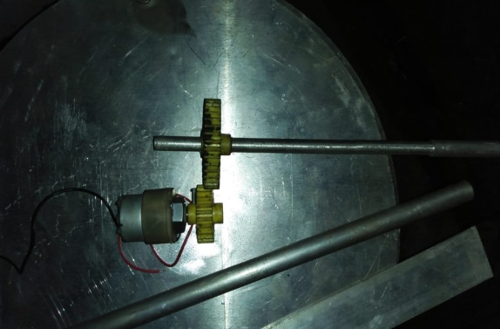
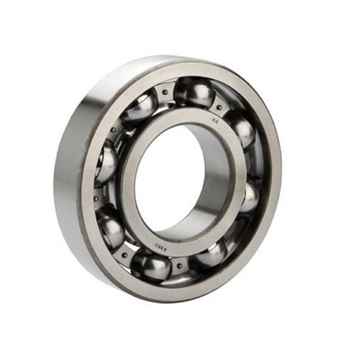
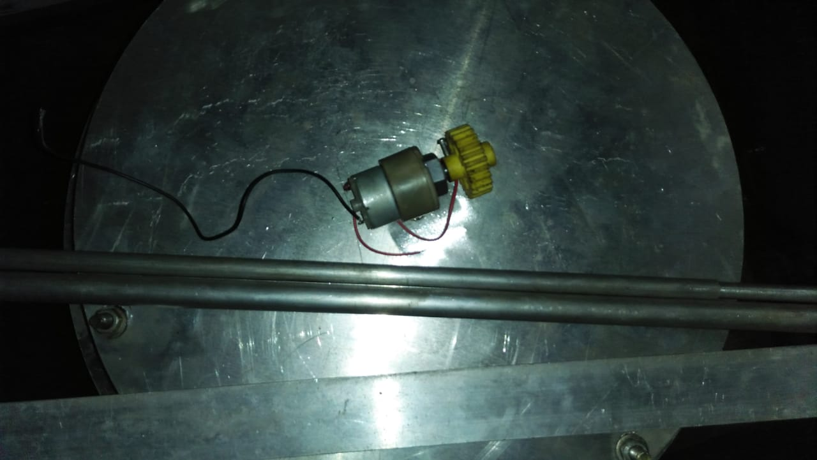
Part | Description | Image
7. Spur gears | They are the simplest and most common type of gear The teeth have an in-volute profile
8. Bearings and Nylon cushion | Rolling element used to reduce rotational friction and support radial and axial loads Nylon cushion used to prevent the magnetic power beyond second base plate
9. Generator | Used to convert mechanical energy into electrical power The specification of the generator used in our VWAT is 12V-500rpm.

Slide 21
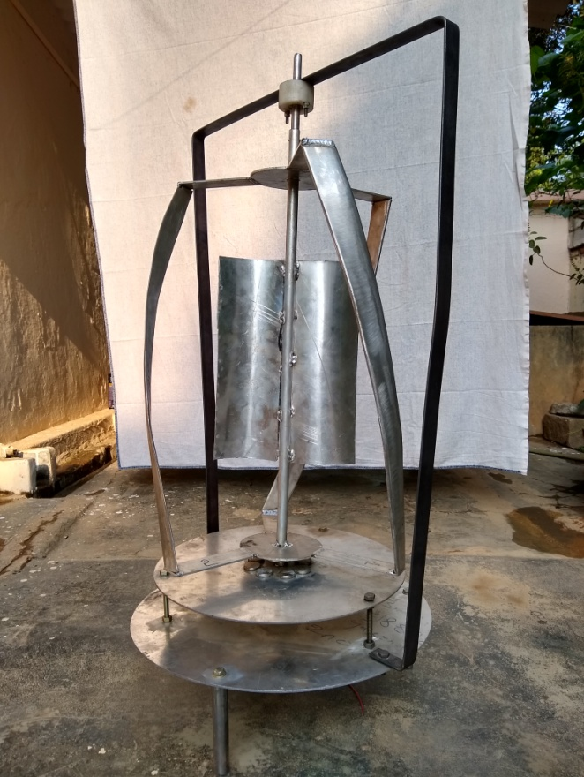
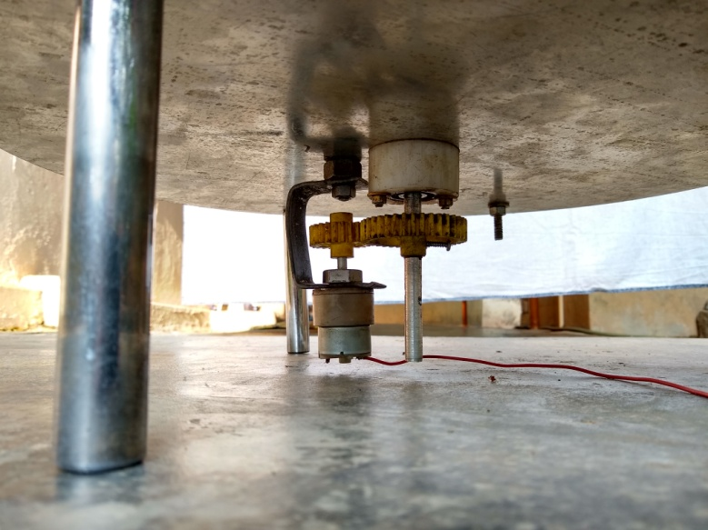
Model
Prototype of Gears and generator assembly
Prototype of VAWT

Slide 22
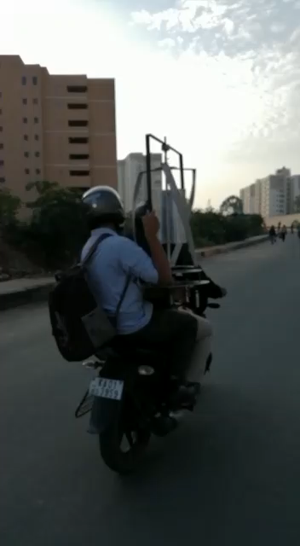

Slide 23
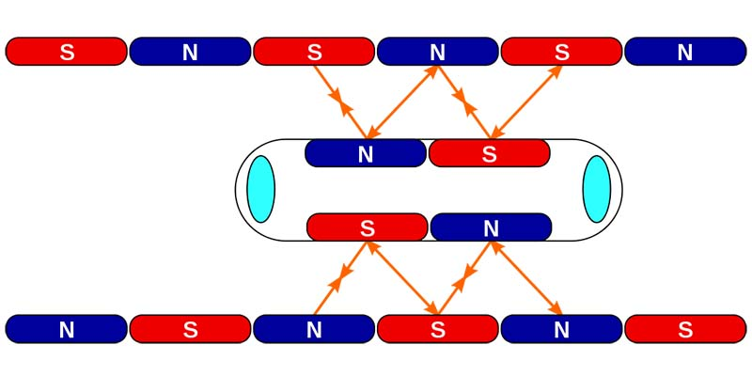
Concept of Electromagnetic Propulsion

Slide 24
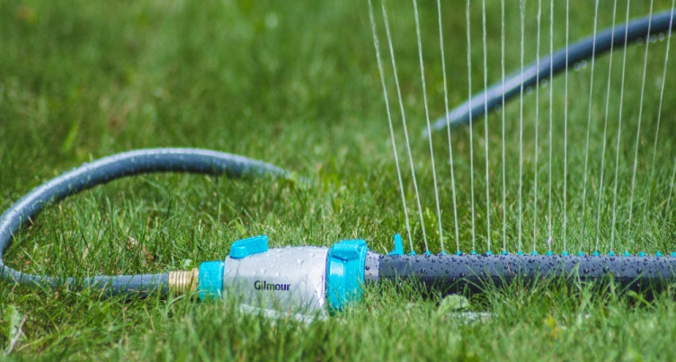
Future work
So, our main focus is to provide economical free and ecologically friendly irrigation of agricultural lands for farmers without any power or fuel consumption. In order to do that we will convert the acquired rotational energy from our VAWT into a linear compressed form to be able to run a sprinkler.
PUMP

Slide 25
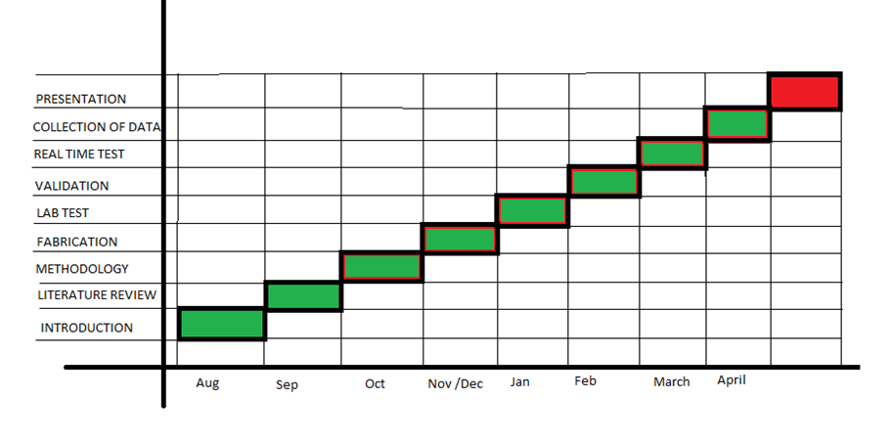
GANTT Chart

Slide 26
References
[1] Ehab Hussein Bani-Hani, Ahmad Sedaghat, Feasibility of highway energy harvesting using a Vertical Axis Turbine, February 13,(2018), (Taylor & Francis E-Journals)
[2] Mahasidha Birajdar, Vertical Axis Wind Turbine for Highway Applications, September (2016), (ResearchGate)
[3] N.C. Batista, R. Melício, Blade Profile for Darrieus Wind Turbines Capable to Self-Start, (2010), (IEEE Xplore)
[4] M Zheng, Y. Li, H. Teng, Effects of Blade No. on Performance of Drag-Type Vertical Axis Wind Turbine, Applied Solar Energy 52(4):315-320, December (2016), (ResearchGate)
[5] Z Afroz, M.Q. Islam, Aerodynamic studies on Multi Bladed S-Shape Vane Type Rotor, January (2012), (ResearchGate)
[6] Swamy, N.V.C., Fritzsche A.A., Aerodynamic Studies on Vertical Axis Wind Turbine, September 7-9, (1976)
[7] Parikshit Ghogare, Vertical Axis Wind Turbine Analysis and Simulation, August (2016), (ProQuest Engineering E-Journals)
[8] Lahu P. Maskepatil, Selection of Material for Wind Turbine Blade by Analytics Hierarchy Process Methods, (2014), (Scientific.Net)
[9] Mishnaevsky L, Branner K, Materials for Wind Turbine Blades: An Overview, November 9, (2017), (MDPI)
[10] J. Damota, I. Lama, Vertical Axis Wind Turbines: Current Technologies and Future Trends, March (2015), (ResearchGate)

